Slide 1

Presenting
The Perilous Adventures
of Time Travel
Book One in The Essence of Time Trilogy
By Randy Gaddo
www.randygaddoauthor.com
Click to advance through the show

Slide 2



Click to advance through the show
Travel through the Time Vortex with Sam, his human friends and animal sidekicks
Song playing is "Time In A Bottle" by Jim Croce

Slide 3

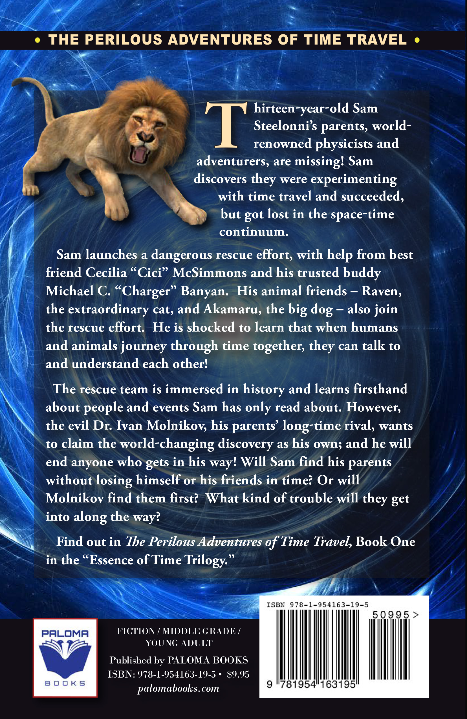
Find out what happens when humans and animals travel through time together

Slide 4
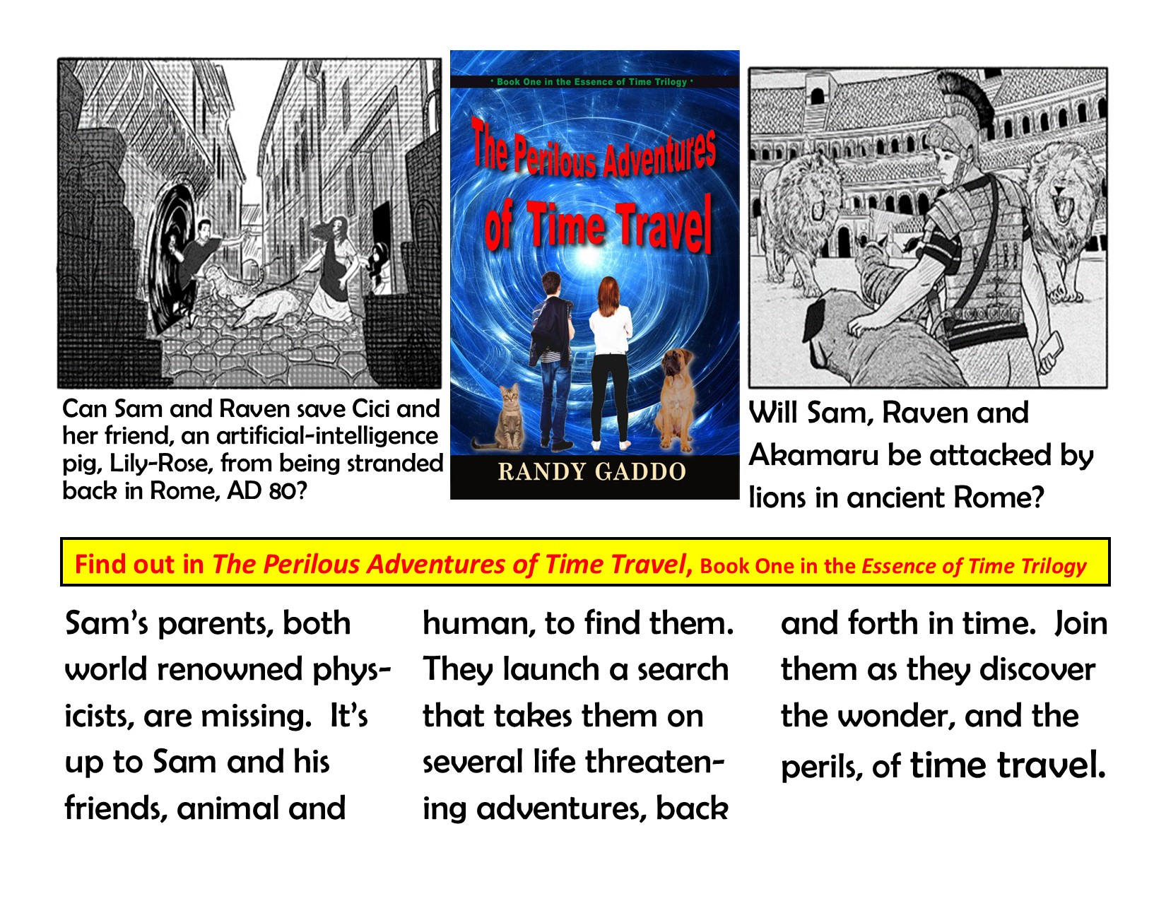

Slide 5

Excerpts from The Perilous Adventures of Time Travel

Slide 6


Slide 7
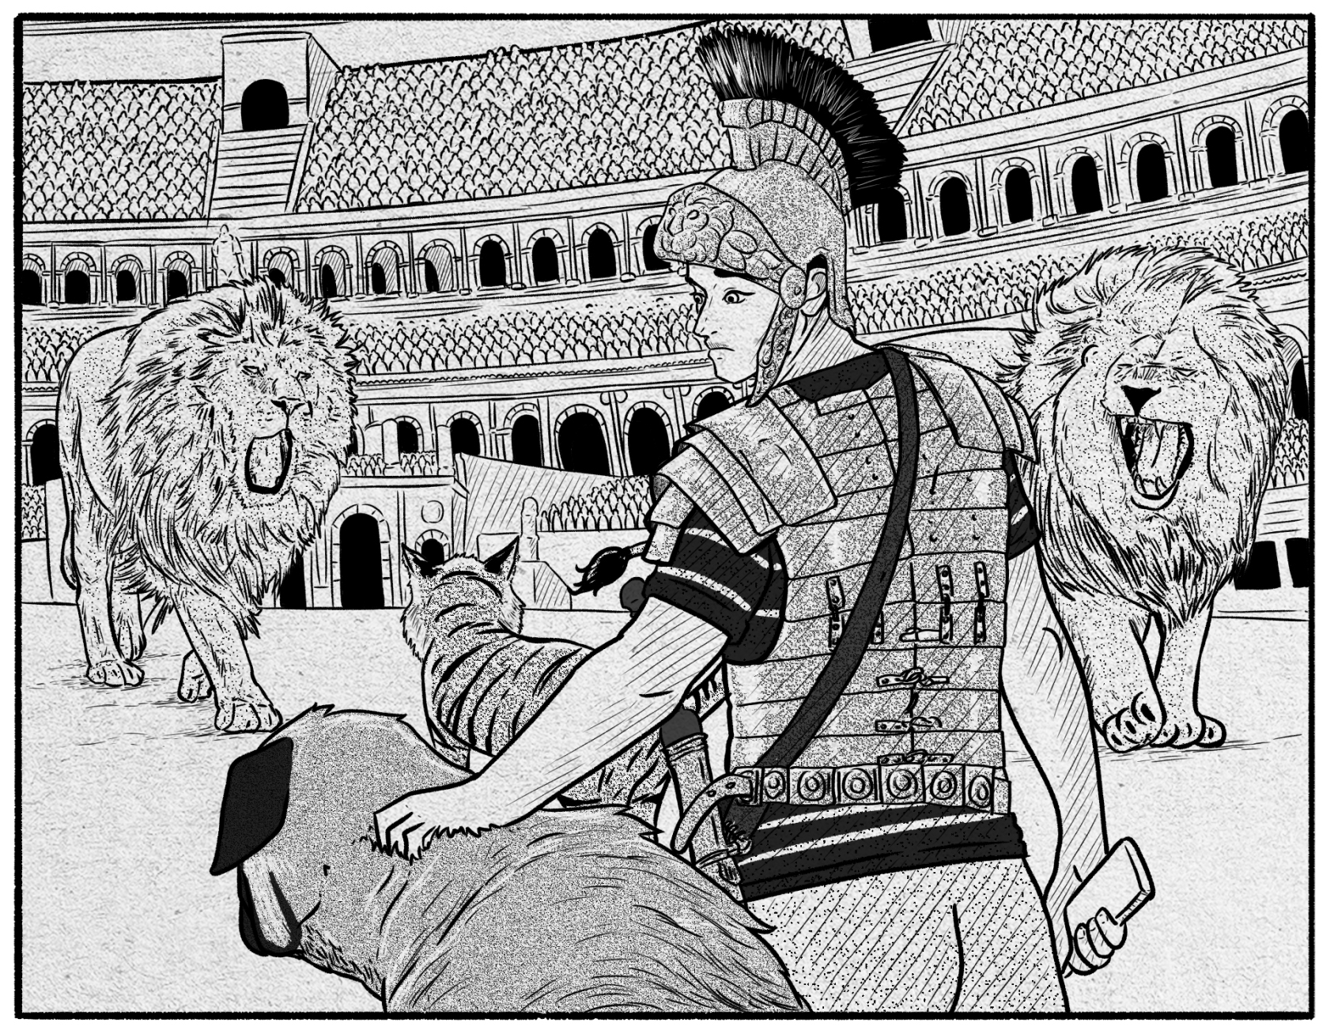
From Chapter 1, p. 1, The Perilous Adventures of Time Travel
Sam shifted his gaze up from the odd-looking remote control device in his hand and was shocked to see in front of him, not twenty feet away, two huge lions drooling at him like he was an appetizer. Behind the lions, seated in an enormous amphitheater that was unbelievably high, were thousands of people shouting and cheering and pointing their thumbs, some up skyward, some down towards the ground. Sam felt something heavy pulling at his waist, and it seemed like there was a fifteen-pound bowl sitting on his head. He looked down and saw the hilt of an ancient sword hanging in an enormous metal scabbard attached to bronze armor plating on his torso. He reached up and felt a solid metal helmet covering his head and the back of his neck. Sam realized he wasn’t in Massachusetts anymore; or maybe he was having a nightmare that felt too real. He didn’t appear to be in his own time zone. From his study of history, it looked an awful lot like he was in ancient Rome! He looked up and saw the gaunt, hungry lions, their fierce eyes blazing, beginning to move slowly towards him. As death appeared imminent, Sam realized it wasn’t a dream; this was real. He suddenly grew very calm and oddly enough flashed back to how he had gotten himself into this mess.

Slide 8


Slide 9
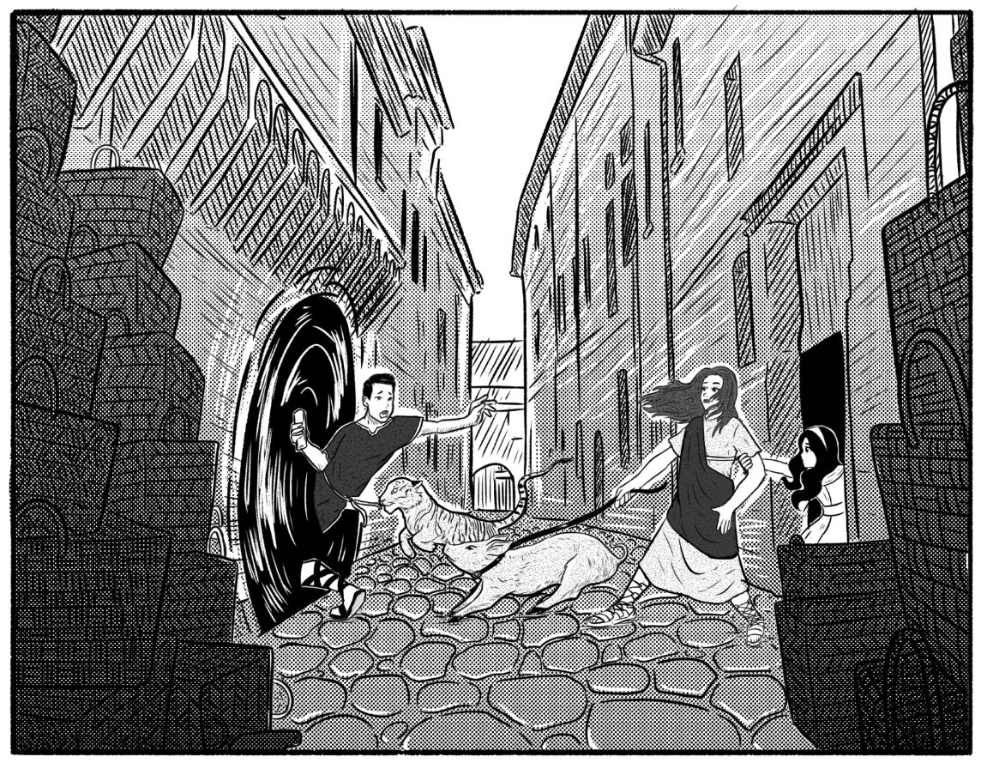
From Chapter 15, p. 96, The Perilous Adventures of Time Travel​
Tragically, that’s not what happened. As Sam and Raven were disappearing in a swirl of smoke and lights, Cici and Lily-Rose were being pulled away from them by the well-intentioned little girl named Maria, who was trying to save them from the soldiers. Sam realized at the last moment that Cici was no longer touching him. He looked back in horror as she and Lily-Rose faded from his sight in a grey whirlwind. “Sam, wait,” she was shouting, in English, reaching out her hand to him. As Sam swirled, he saw the soldiers marching by their alleyway. Cici’s shout drew the attention of the closest soldier, who snapped his helmeted head towards the alley. He saw a small dust storm and would later think he remembered seeing a young man shouting in a strange language and a large cat, but then they faded and all he saw was an empty alley. He marched on; he was not going to tell anybody that he thought he saw a ghost. “Cici!…” Sam was shouting as he swirled again to see Cici, Lily-Rose and Maria disappear into the alley doorway. Then the alley faded and was lost in the cyclone that took Sam and Raven back home and left Cici and Lily-Rose stranded in Rome, AD 80.

Slide 10


Slide 11
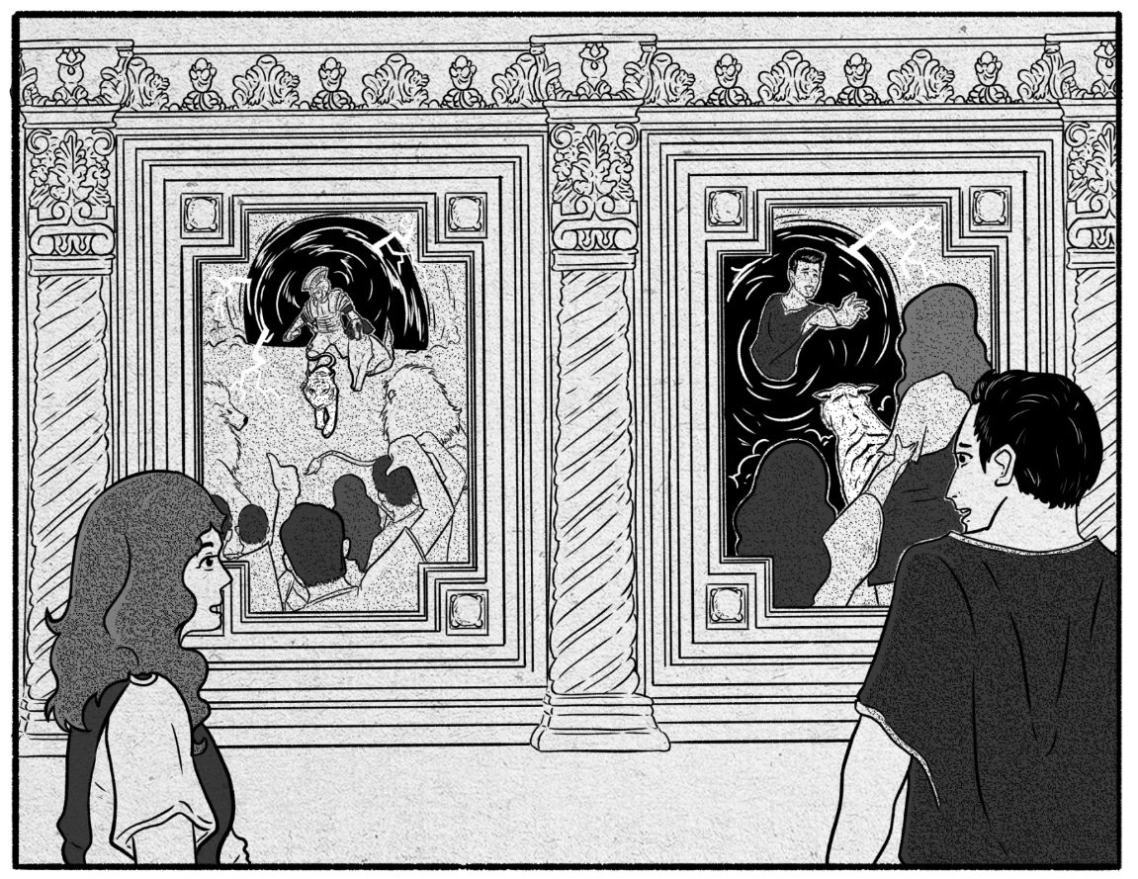
From Chapter 18, p. 116, The Perilous Adventures of Time Travel​
“Ah, those are family heirlooms passed down for four generations,” she said. “They were painted by an artist who was a close friend of my great-great grandfather.” As she was telling the story, Amanda and Tony were studying the painting. It showed all the things she was describing. While the figures were too small to really show facial features, the tawny-colored cat with the long tail was a close match for Raven. They looked at each other silently passing an “OMG!” These paintings clearly showed Raven and that meant that both the gladiator and the boy who visited Guiseppe’s house was Sam. The girl with him had to be Cici, who was always getting caught up in Sam’s escapades; the flaming red hair was a strong indicator. Tony didn’t know where the pig came from, but he knew this meant their son was trying to find them and was getting deep into something he didn’t understand; something that could be dangerous.

Slide 12


Slide 13
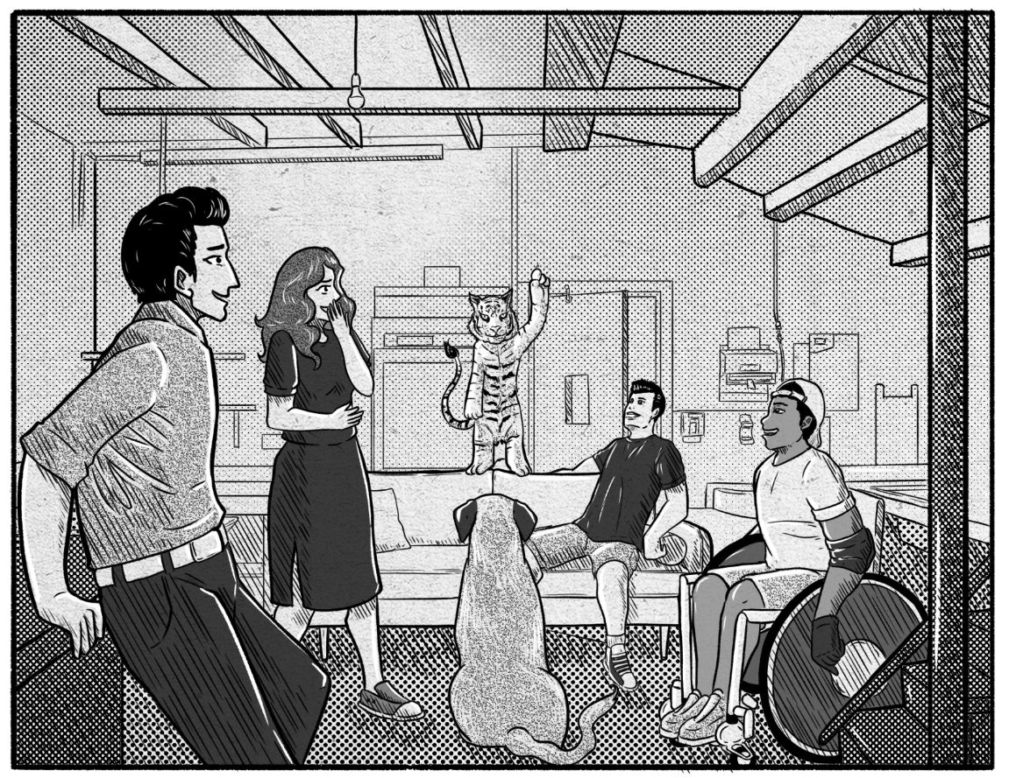
From Chapter 20, p. 131, The Perilous Adventures of Time Travel​
There was a long silence as everyone absorbed the enormity of the task before them. Then, from the back of the sofa came a gravelly voice, sounding like a Marine Corps drill instructor talking to a platoon of new recruits. “OK ladies and gentlemen, I suggest you get your giant brains and your opposable thumbs into gear and start solving all these problems, because we are now fully engaged in Operation Retrieve Cici and Lily-Rose. It’s time to bring them home!” said Raven, standing stoically on his hind legs astride the back of the sofa, his front paws clenched into fists, his knuckles resting on his hips, looking stern. Then he gave them all a smile and a wink and said, “Bet you folks would never have guessed I could do that, did ya’?” There was a long pause, and then they all burst out laughing. Raven’s humor was the catalyst to set them in motion. From this point forward they had one shared goal: figure out how to get Cici and Lily-Rose home.

Slide 14
Click to advance through the show
Look Into The Future
Book Two, Essence of Time Trilogy
Coming Soon

Slide 15
WWW.randygaddoauthor.com
Book Two Teasers!
-Cici becomes a gladiator
- Lily-Rose saves the day
- Molnikov exercises evil
- Sam and his team battle time and Molnikov as they launch their plan to get Cici and Lily-Rose home

